Slide 1
ESE516 A9 - ASSEMBLY
Eduardo Garcia
April 4th , 2022

Slide 2
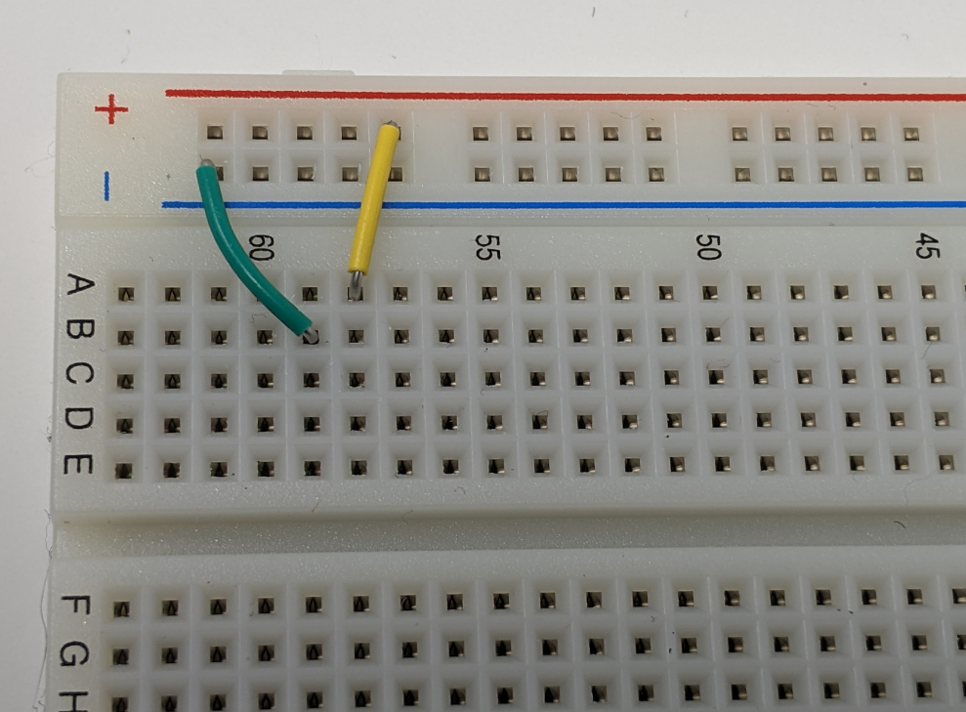
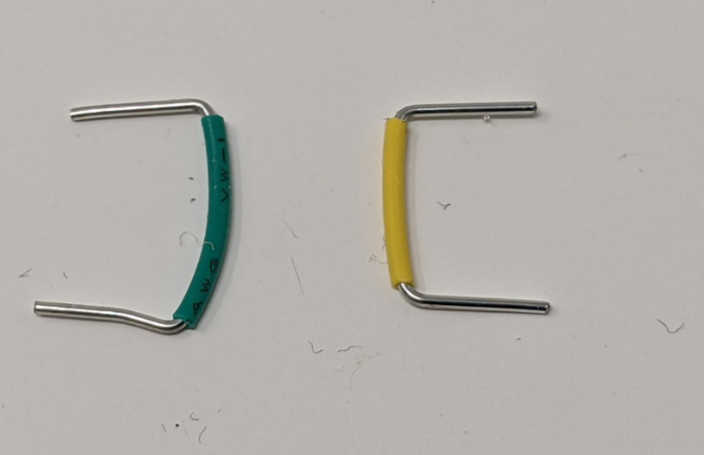
Put jumpers in the respective positions on your breadboard.

Slide 3
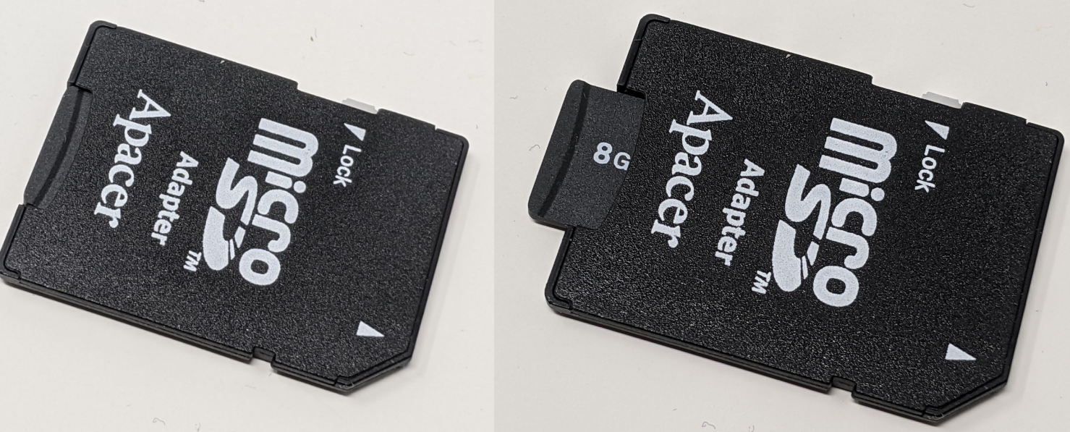
Remove Micro SD Card from Holder

Slide 4
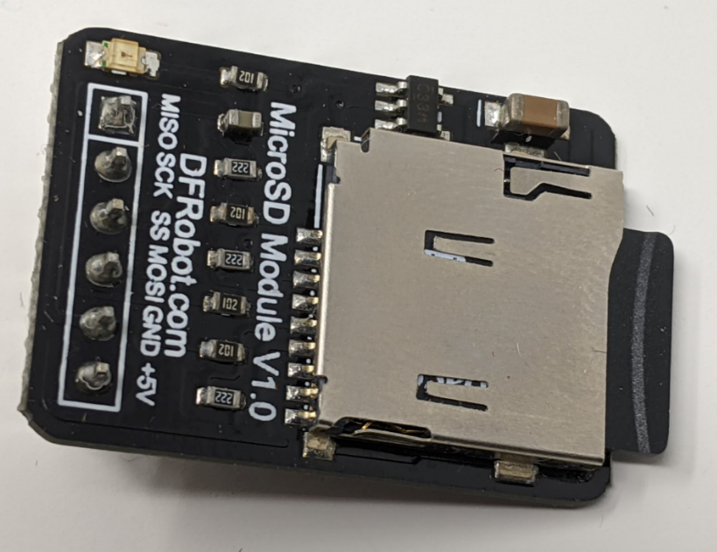
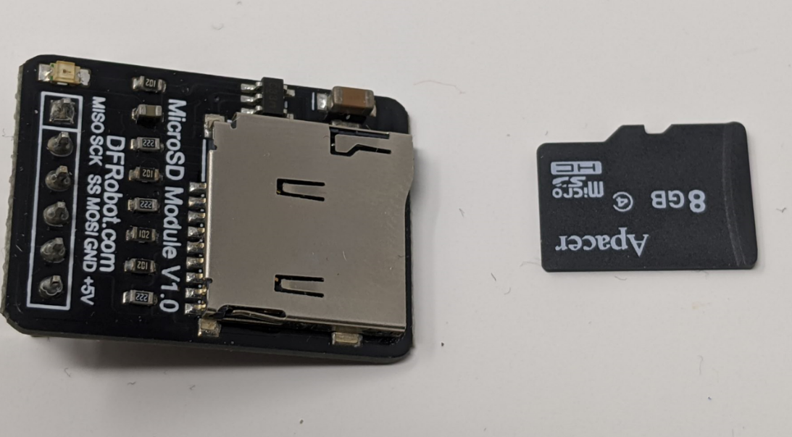
Put inside the micro sd card module

Slide 5
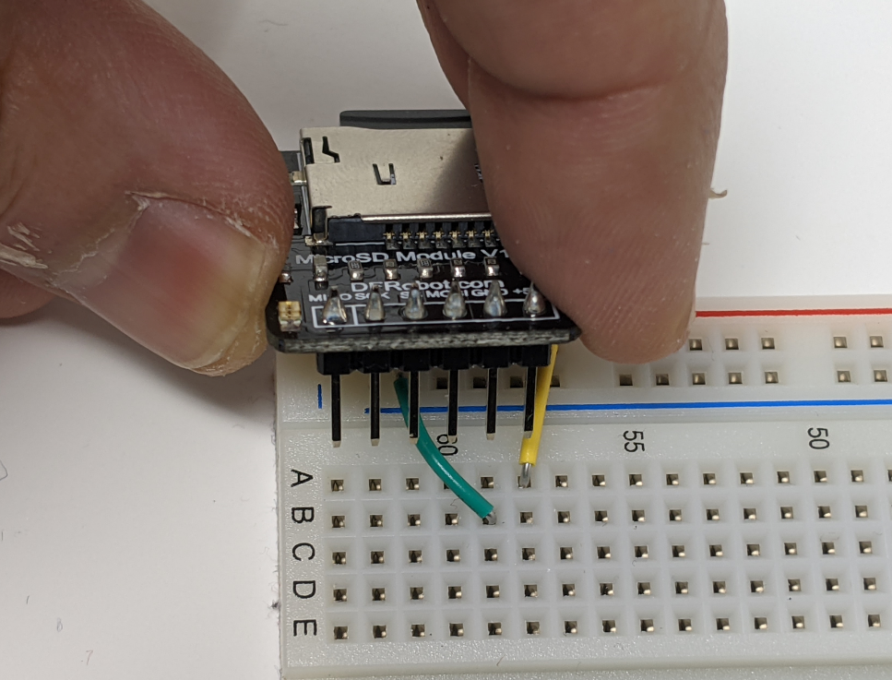
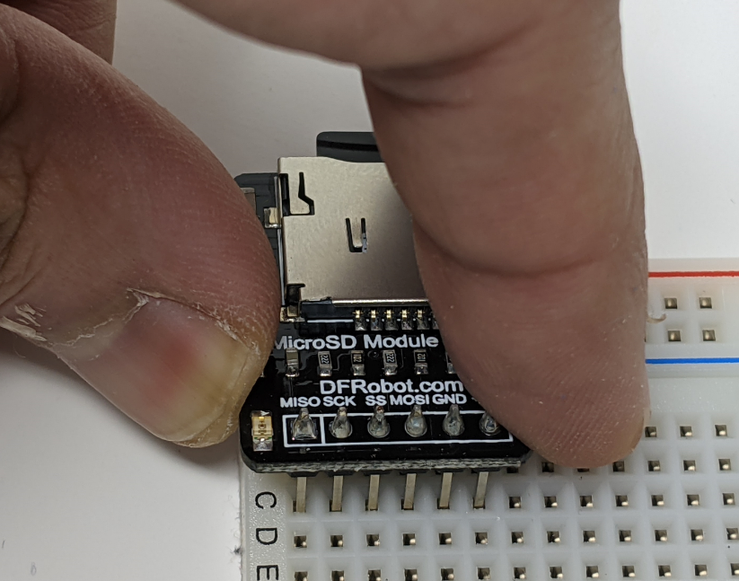
Plug micro sd card holder in place as shown below

Slide 6
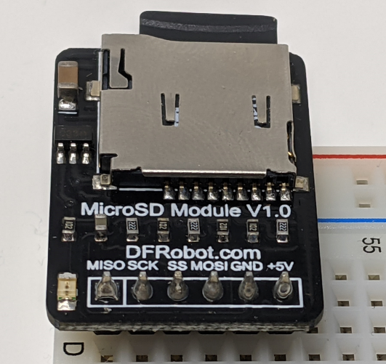

Slide 7
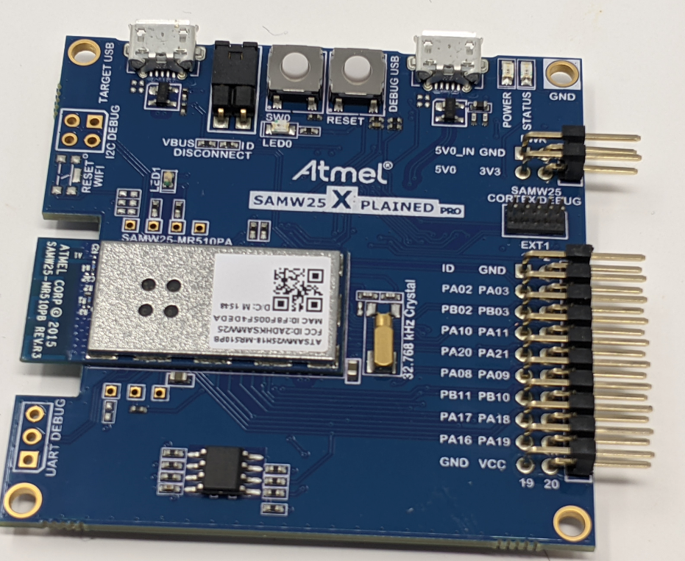
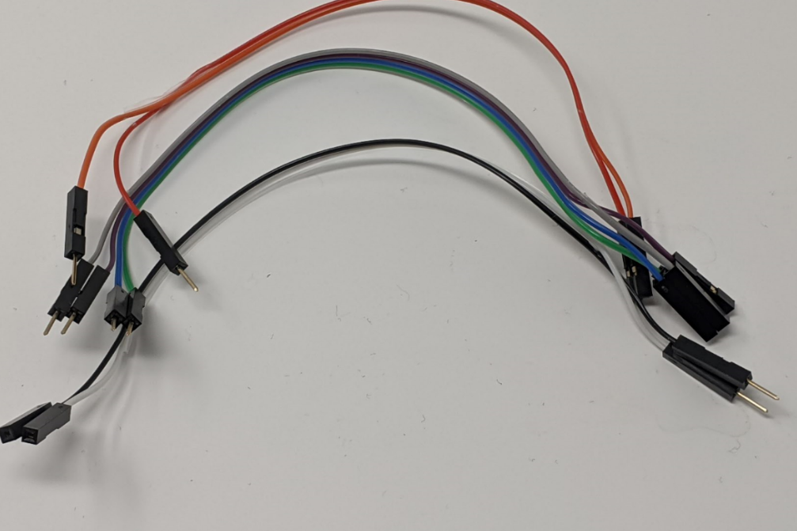
Grab F to M jumpers (x8) and your dev board

Slide 8
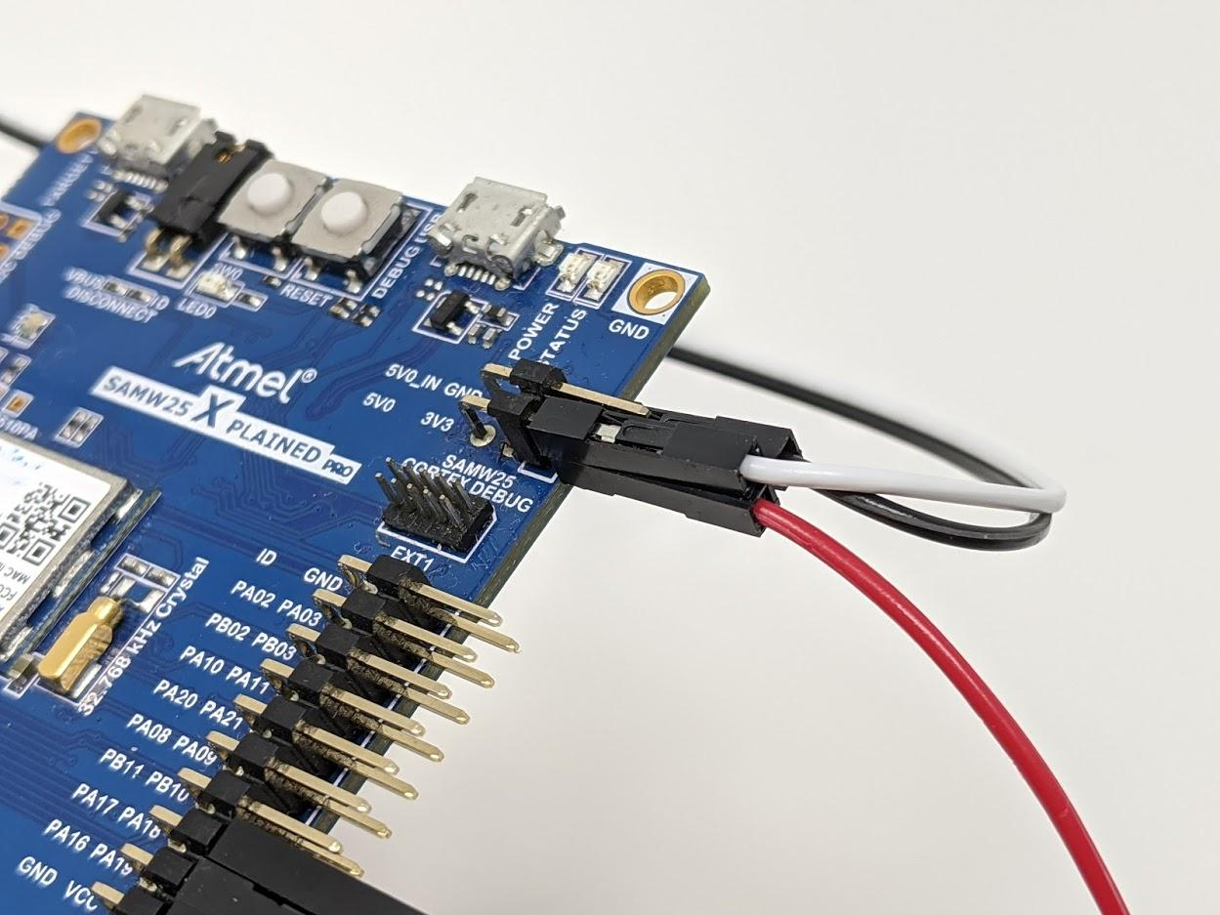
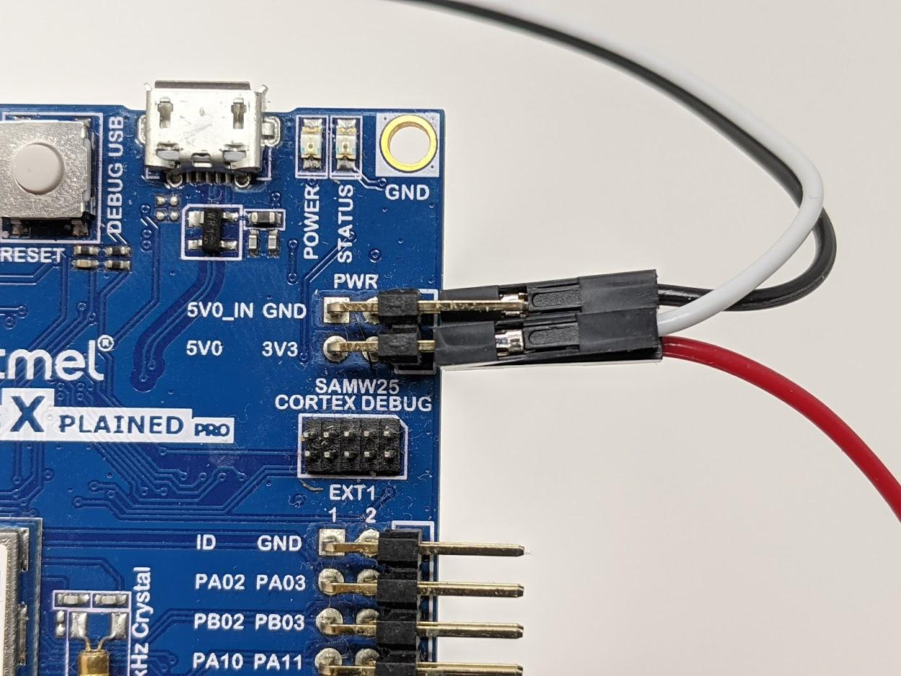
Connect 2 cables – one to GND, another to 5V0 (Please ignore 3V3 cable in Image)

Slide 9
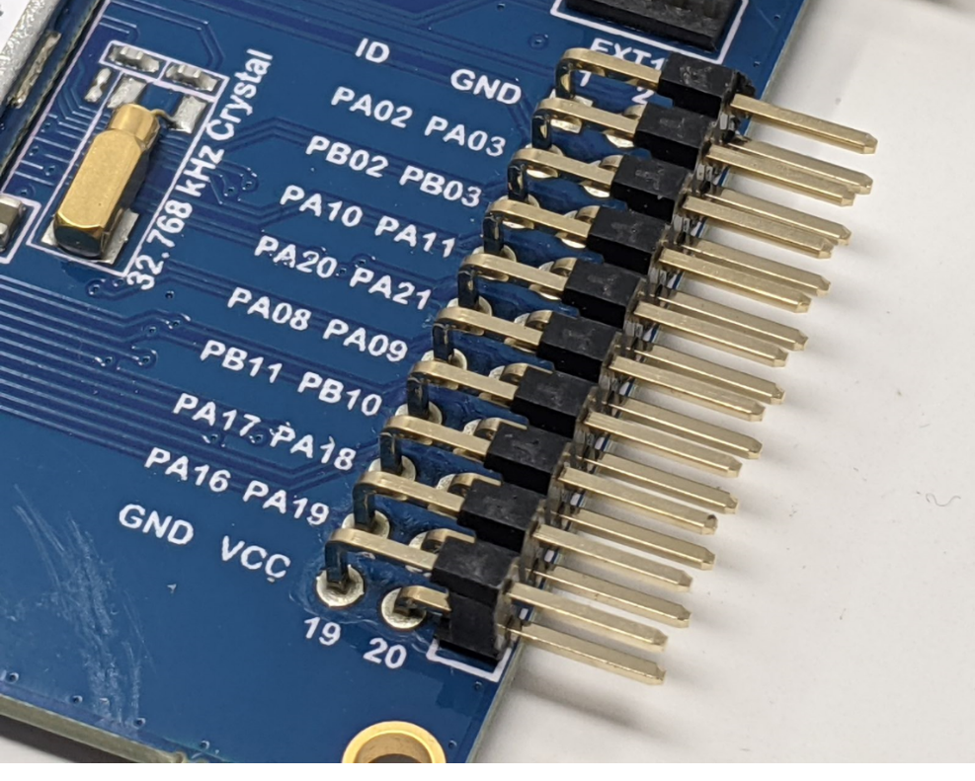
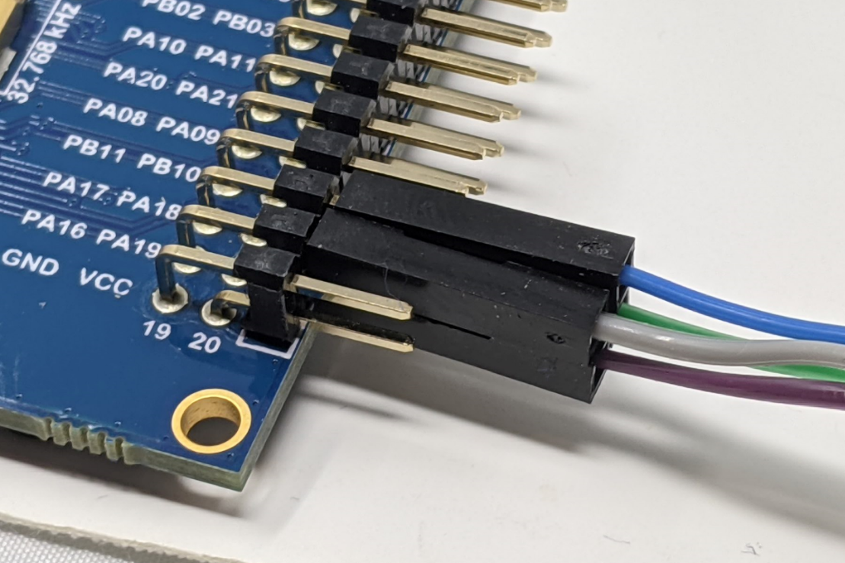
Connect 4 wires for SPI
PA16 (MISO) (gray below)
PA17 (CS) (blue below)
PA18 (MOSI) (green below)
PA19 (SCK) (purple below)

Slide 10
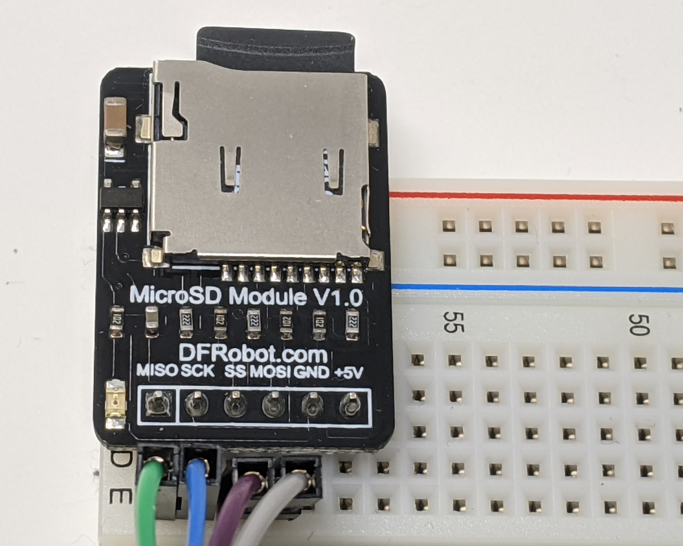
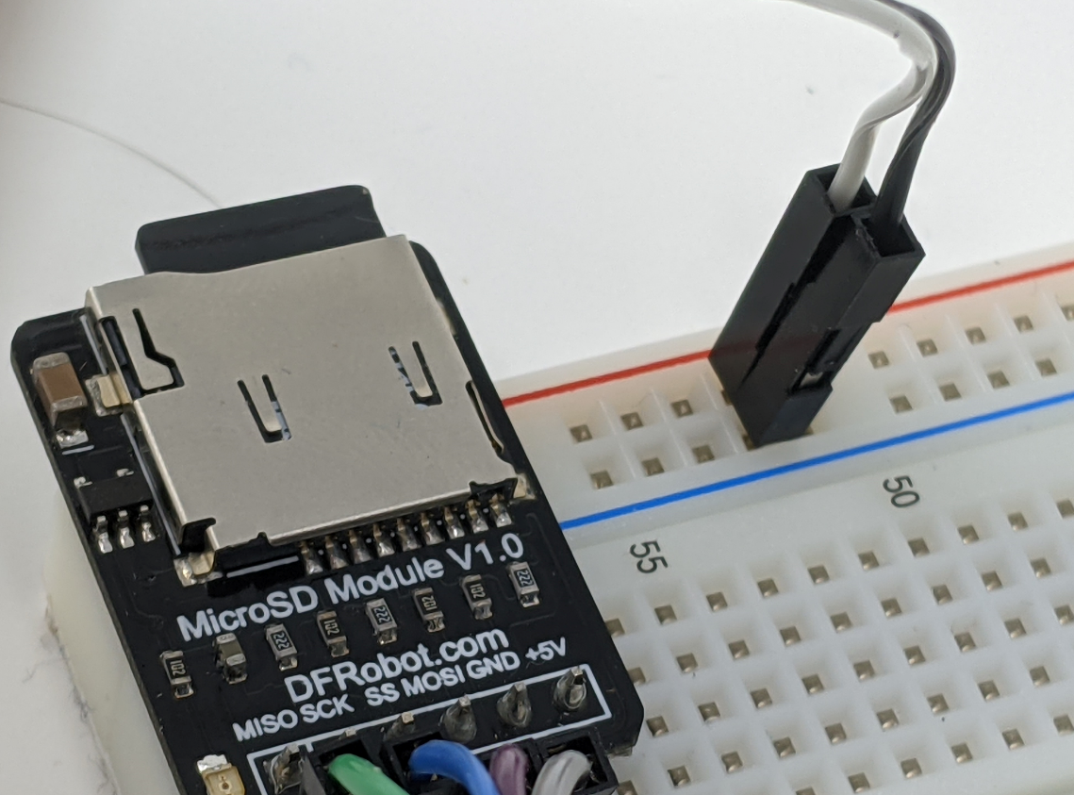
PA16 (MISO)
PA17 (CS)
PA18 (MOSI)
PA19 (SCK)
Connect 5V to red rail and GND to blue rail of breadboard as shown below.
Connect wires as shown below for SPI (sorry – the image below changed the colors. Connect to the respective signal
MISO
SCK
SS
MOSI

Slide 11
